Slide 1
AI Loan Eligibility Assessment Assistant
Team Gradient
Multi-Agent Workflow Orchestration using RAG and LangGraph
Finance Domain — UST Enterprise Capstone

Slide 2

Problem Statement
Operational Inefficiency
Manual loan processing is slow and inefficient, leading to high operational costs.
Decision Inconsistency
Risk evaluation is inconsistent across different manual assessors.
Compliance Bottlenecks
Manual policy validation increases delays and risk of human error.
Strategic Need
Need for AI-driven workflow automation to modernize lending practices.
Goal: Automate loan eligibility assessment

Slide 3

Project Objectives
Assessment Automation
Automate loan eligibility assessment to increase speed and reduce operational overhead.
Agent Orchestration
Build a robust multi-agent orchestration workflow for specialized task handling.
Intelligent Routing
Implement router-based approvals to ensure logic-driven decision paths.
Policy Retrieval (RAG)
Integrate RAG for precise policy retrieval to maintain strict compliance standards.
Transparency
Improve workflow transparency with clear logging and state tracking.
Human-in-the-loop
Support human approval checkpoints for critical edge cases and risk mitigation.

Slide 4

Why Multi-Agent Architecture?
Specialized Agents
Individual agents dedicated to handling distinct and specific tasks within the ecosystem.
Better Modularity
Deconstructs complex processes into manageable, interchangeable modules.
Simple Maintenance
Streamlines orchestration and simplifies long-term maintenance of the system.
Enterprise Simulation
Mimics complex enterprise workflows for more realistic and robust simulations.
Scalable & Flexible
Effortlessly scales to meet growing demands while maintaining operational flexibility.

Slide 5
Agent Responsibilities
Agent | Responsibility
Financial Analysis Agent | Analyze applicant financial profile
Fraud & Verification Agent | Verify applicant documents and fraud signals
Risk Assessment Agent | Classify LOW / MEDIUM / HIGH risk
Recommendation Agent | Generate loan eligibility recommendation
Human Escalation | Review risky applications manually

Slide 6
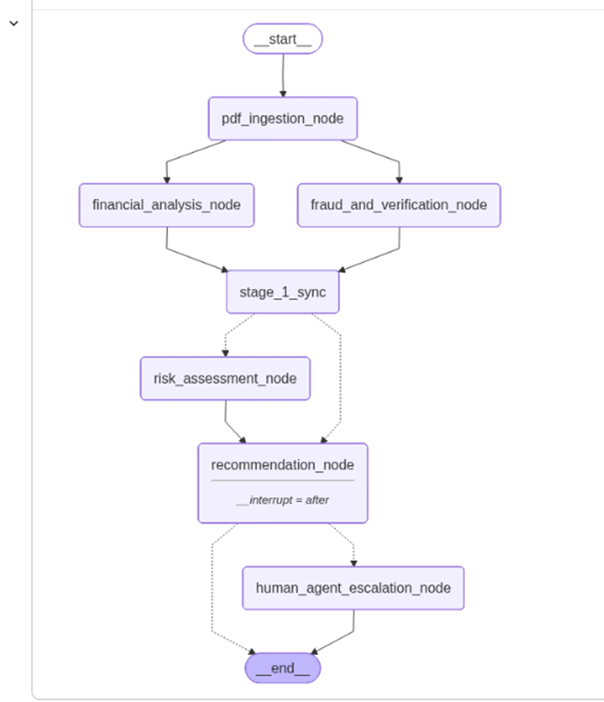
System Architecture

Slide 7
Technology Stack
Category | Technology Used
Agent Framework | LangGraph + LangChain
LLM | Gemini 2.5 Flash
RAG Components | LangChain (PyPDFLoader, Recursive Character TextSplitter)
Vector Database | ChromaDB
Programming Language | Python

Slide 8
RAG Pipeline
Lending Policy Documents
PyPDFLoader
Text Chunking
Embeddings
ChromaDB Vector Store
Retriever Tool
Policy Context Returned
Recommendation Node

Slide 9
Workflow Design
01. PDF Ingestion
Automated intake and parsing of loan application documents.
02. Parallel Analysis
Concurrent financial analysis and fraud verification processing.
03. Synchronization Stage
Merging parallel data streams into a unified workflow state.
04. Risk Assessment
Evaluation of applicant data against lending policies.
05. Recommendation
Generation of automated loan approval or denial suggestions.
06. Human Escalation
Manual review by loan officers for high-risk or complex cases.

Slide 10
Live Demo
Step 1
Upload Loan Application PDF
Step 2
Extract Applicant Information
Step 3
Execute Multi-Agent Workflow
Step 4
Retrieve Lending Policies
Step 5
Generate Risk Assessment
Step 6
Produce Recommendation
Step 7
Human Escalation for High-Risk Cases

Slide 11

Memory & Context Handling
Workflow state is maintained across LangGraph nodes.
State includes:
Applicant details
Financial analysis results
Fraud verification status
Risk classification
Recommendation output
Benefits:
Unified visibility across all processing agents.
Seamless handoffs between complex decision nodes.
Ensures data integrity during parallel execution.

Slide 12
Error Handling & Robustness
Input Integrity
Validation checks for invalid inputs to ensure data quality from the start.
Graceful Failures
Smart handling for missing fields, preventing system crashes during processing.
API Resilience
Automated retry and fallback mechanisms for external API dependencies.
Stateful Recovery
Persistent state tracking allows for seamless recovery during workflow interruptions.

Slide 13
Challenges Faced
Multi-Agent State
Handling complex multi-agent state transitions effectively.
RAG Latency
Optimizing retrieval latency for processing large PDF documents.
Risk Classification
Ensuring consistency in AI-driven automated risk classification.
Data Integration
Integrating diverse financial data formats and complex schemas.

Slide 14
Future Enhancements
OCR Support
Support for scanned PDFs to broaden data ingestion capabilities.
Banking Integration
Real-time connectivity with financial institutions for instant verification.
Explainable AI
Enhanced transparency in AI decision-making for regulatory compliance.
Fraud Detection
Advanced heuristics to identify and mitigate sophisticated fraud attempts.
Cloud Deployment
Full migration to cloud-native architecture for infinite scalability.
Monitoring
Enhanced real-time dashboard for comprehensive system health tracking.

Slide 15
Conclusion
The project successfully demonstrates a scalable architecture for:
Multi-agent orchestration
RAG pipelines
Router-based workflows
AI-driven decision systems
Automated enterprise loan assessment

Slide 16
Q&A
Questions & Discussion
We'd love to hear your thoughts and inquiries.
Thank You

